Slide 1

Bender Trust
Analysts: Vineet Varghese, Ryan Tourtello, Michael Schelhorn, Julian Zane, Bogdan Bozhkov
11/2025

Slide 2
Company Overview
Aptiv PLC (APTV) is a global auto-tech supplier focused on making cars safer, greener, and more connected.
The company is a spin off of Delphi Automotive, which used to be part of general motors.
Aptiv builds the “nervous system and brain”, including:
Wiring
Data Sensors
Computers
Driver Assistance Software
Vehicle Updates + Connectivity
They operate across North America, Europe and Asia with a highly diversified customer base, selling to virtually every major automaker worldwide.
Aptiv organizes its systems into three parts:
Electrical Distribution Systems (EDS): The wiring and electrical pathways of a car.
Engineered Components Group (ECG): The connector systems and “plug and play” building blocks.
Advanced Safety & User Experience (AS&UX): Sensing, commuting, and software.

Slide 3
Industry Analysis
Works in the automotive parts section of the automotive technology industry.
Split into two business segments: Signal & Power Solutions / Advanced Safety & User Experience
Global Automotive Supplier Market: $997.4B (2022) → $1.34T by 2033
Competitors
  Signal & Power Solutions: Yazaki & Sumitomo Electric
  Advanced Safety & User Experience: Bosch & Continental
Strong Revenue per EV due to high wiring contents & electronic vs ICE vehicles
EV Policy & OEM has a shift towards greener vehicles that are more software based.
Even with tariff pressure , OEM sources important electronics from outside sources. Aptiv posted positive earnings that were adjusted earnings in that last two quarters.

Slide 4
Porter’s Five Forces
Suppliers Power
Customers Power
Threat of Substitutes
Competition in the Industry
New Entrants
Low to Moderate
Commodities and many parts can be bought from many places, so Aptiv has high buying power
Chips/Sensors can be harder to obtain as there are fewer sources, meaning more leverage for suppliers
Aptiv reduces risk by using multiple suppliers and making long-term deals
Medium
Some automakers, like Tesla, develop their own electronics and software, which can replace what they would normally buy from suppliers like Aptiv.
New designs, such as wireless systems, could also reduce the need for certain components.
However, as vehicles become more electric and software-reliant, the demand for Aptiv technology continues to grow.
High
Aptiv's competition are world's top tier suppliers such as Bosch, Continental, Denso, ZF, Magna, and Visteon.
In the industry, the automakers choose suppliers through bidding, and since all major companies are racing to provide better technology at lower cost, competition is very high.
Low
Making car-grade electronics requires enormous research and development, which is hard and expensive.
Car makers only trust reliable suppliers with years of experience and proven parts.
Once approved, a new part stays in the vehicle for many years.
High
A few large automakers control most of the industry’s purchasing power, giving them leverage to negotiate lower prices.
However, since the parts Aptiv supplies have to be designed in the car, the automaker usually keeps the supplier for the entire model cycle which is around 5–7 years.
This creates stability and incentivizes automakers to keep suppliers, which helps Aptiv keep the business running.

Slide 5
Risks & Mitigants
Risks:
Automotive Production Based on the Economy
Automotive Buyers Have Buying Power
Disruptions in Supply Chain
Falling behind in Tech & Product Defects
Trade, Regulation, & Location Issues
Mitigants:
Large Global Customer Reach, Content per Vehicle increasing, Strong Liquidity
Focus on R&D, Long-term contracts, Various OEM Customers
More inventory, Long-term Supplier, Global Scale
Large Engineer Force, New Partners & Tech, Top Quality, & Rigorous Testing
Global Manufacturing Presence, Localization Strategy, Not Focused in One Country, Strong Compliance to Regulations

Slide 6
Investment Thesis
Hold Aptiv

Slide 7
Investment Thesis
Aptiv holds an important position in the automotive supply chain. Their exposure to electrification, advanced driver assistance systems (ADAS), and connectivity are long-term growth areas. Aptiv is positioned well to benefit as automakers transition toward electric and autonomous vehicles. The company’s valuation multiples are relatively low compared to peers, which could make it attractive if execution improves.
Despite its positive outlook, caution is warranted. Aptiv has struggled with profitability, posting recent net losses and record a large goodwill impairment that raises questions about management’s capital allocation. They also carry significant debt and are vulnerable to swings in global auto demand, raw material inflation, and supply chain disruptions. These risks temper the upside potential and explain why the stock trades at a discount.
Taken together, the most balanced position is to hold Aptiv. The company has credible exposure to long‑term automotive technology trends, but near‑term execution risks and financial constraints make it premature to buy aggressively. On the other hand, its industry relevance and potential for recovery argue against selling outright. Holding will allow investors to monitor whether Aptiv can stabilize margins and demonstrate consistent profitability before committing further capital.

Slide 8
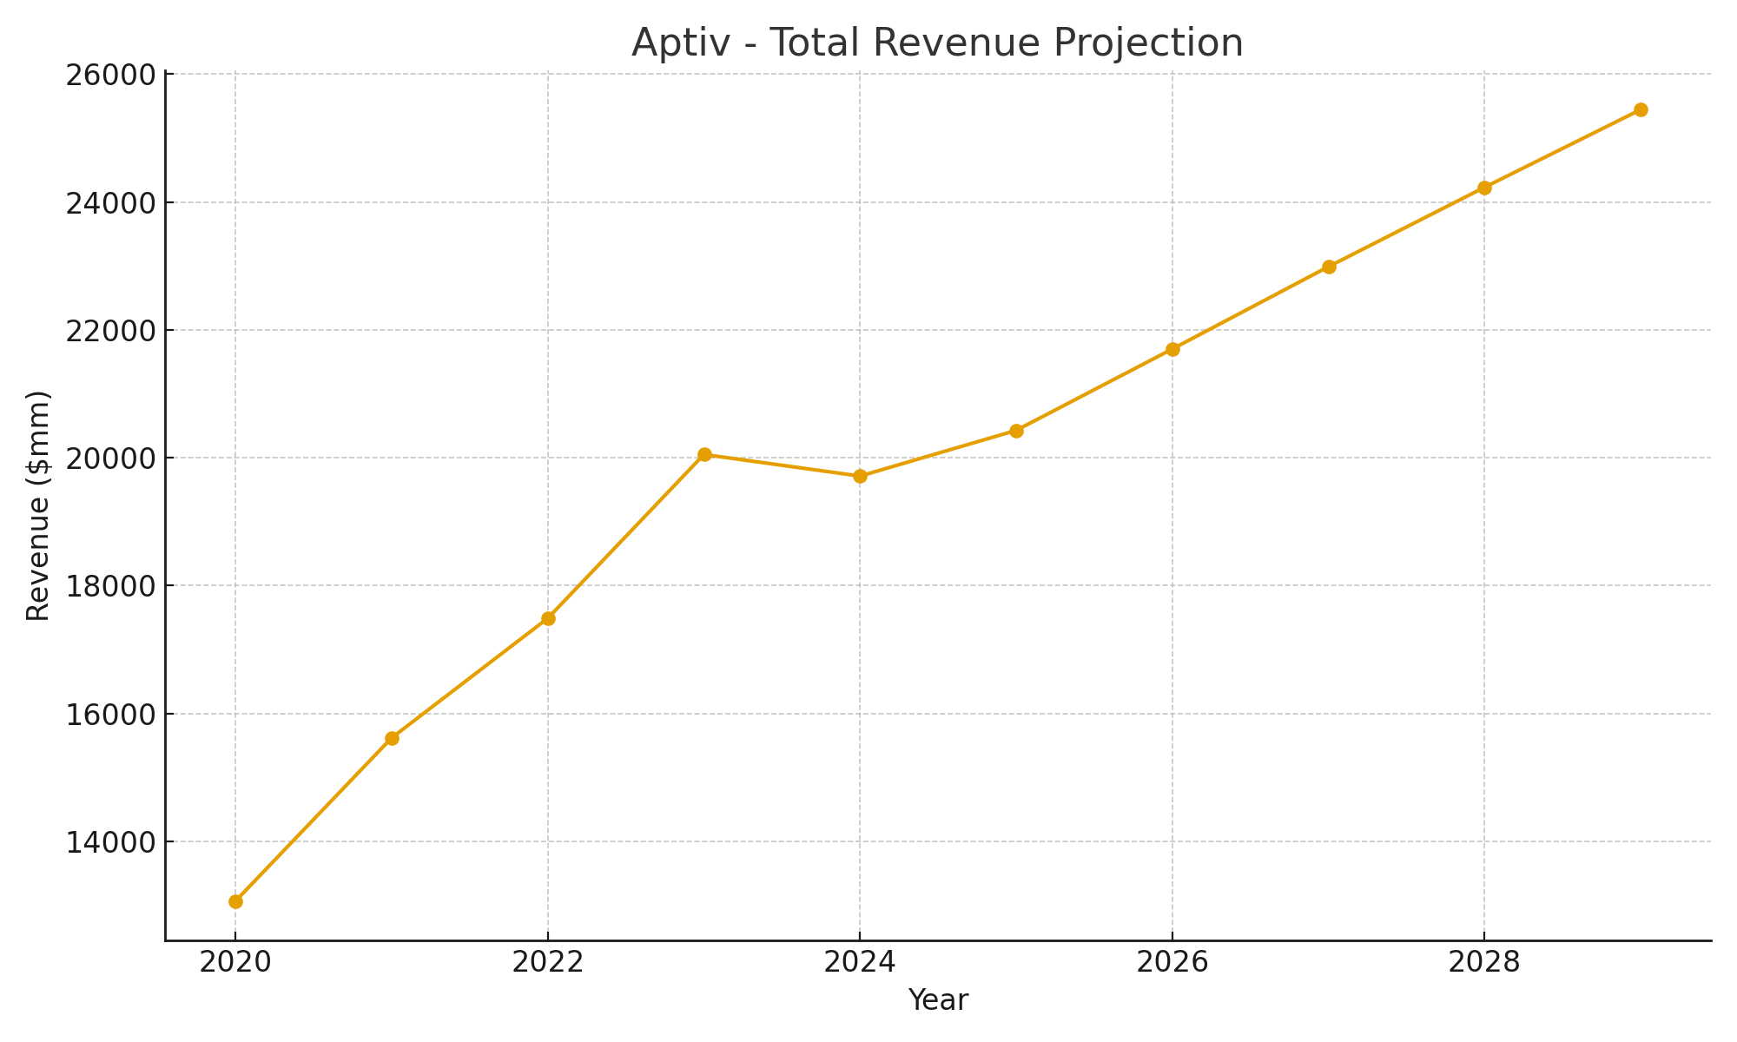
Financials

Slide 9
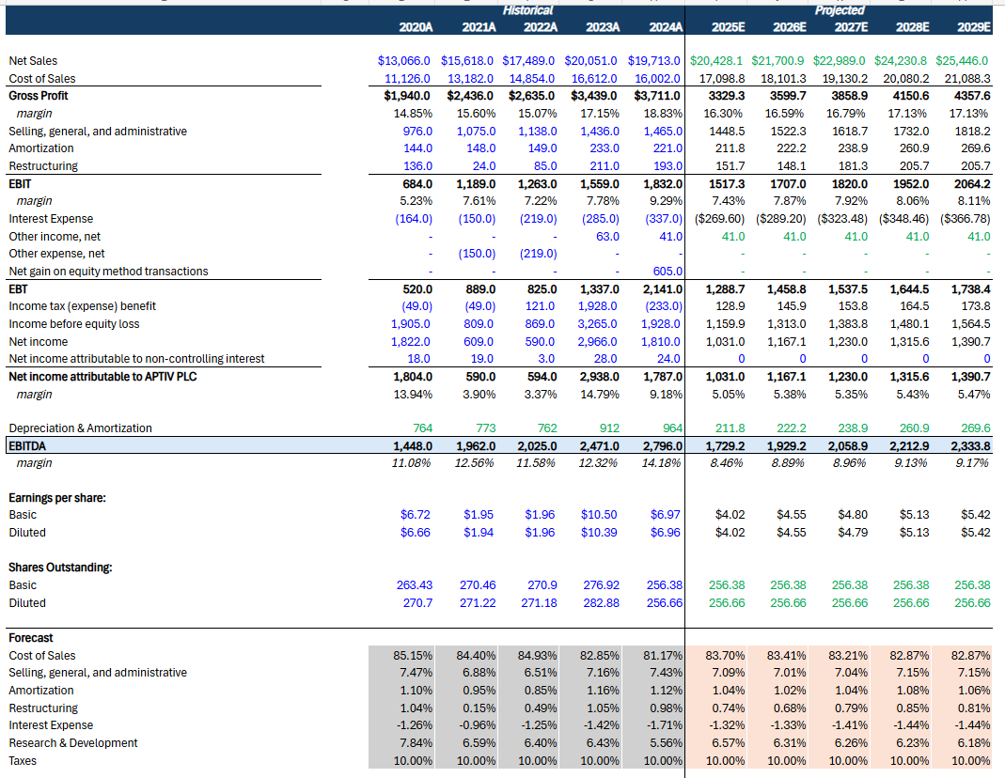
Income Statement

Slide 10
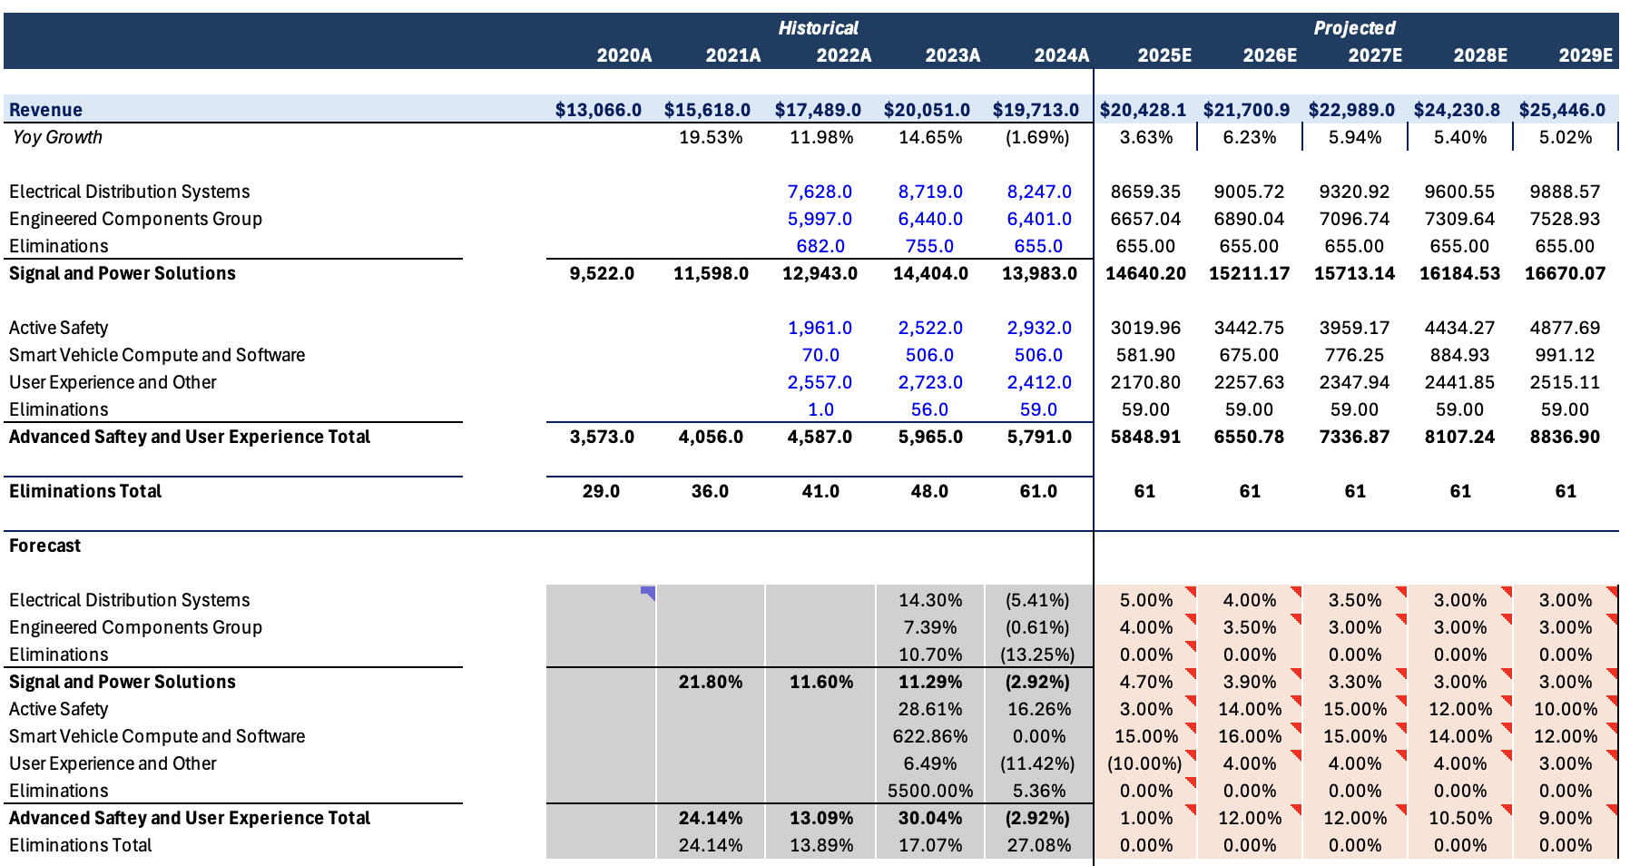
Revenue Build

Slide 11
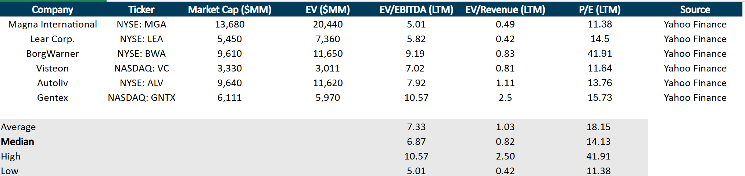
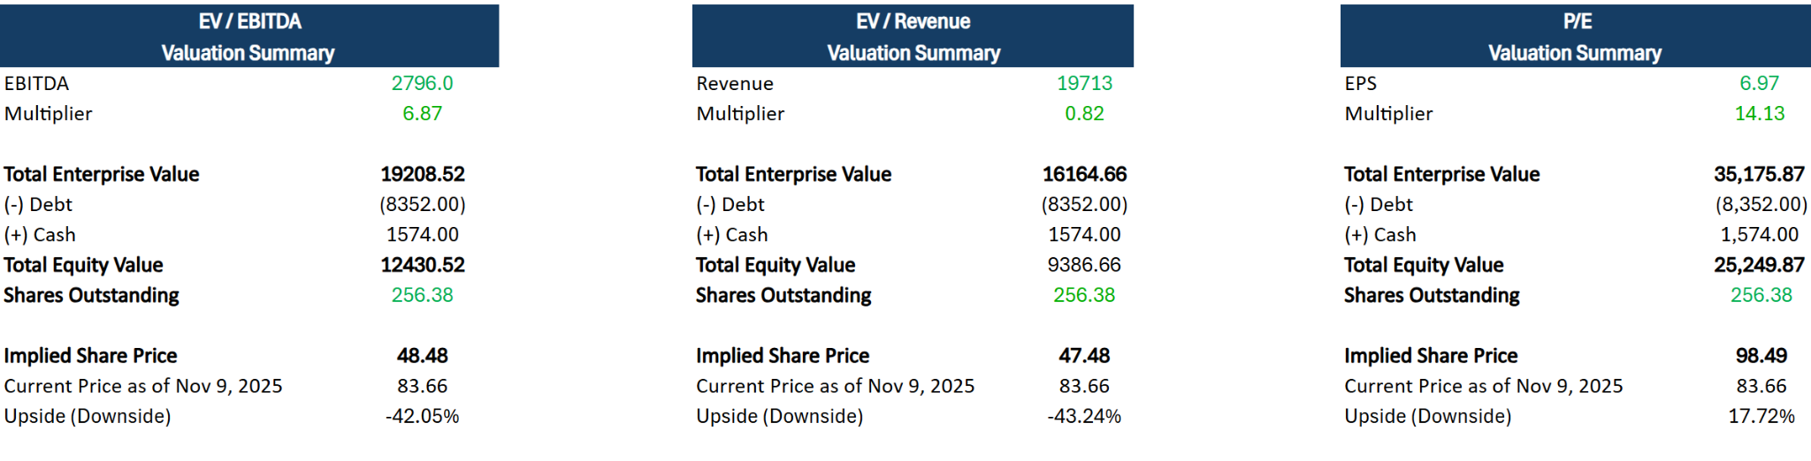
Competitors & Valuation

Slide 12
Thank you!

